Slide 1




solve-a-thon 1.0
organized by
MCA Dept SIT Mangalore
Team Name : Logic Drifts
Team Leader Name : Rohini Durgadas Moger
Problem Statement : "PlacementPro" – The Integrated Campus Career Suite Target Platform

Slide 2
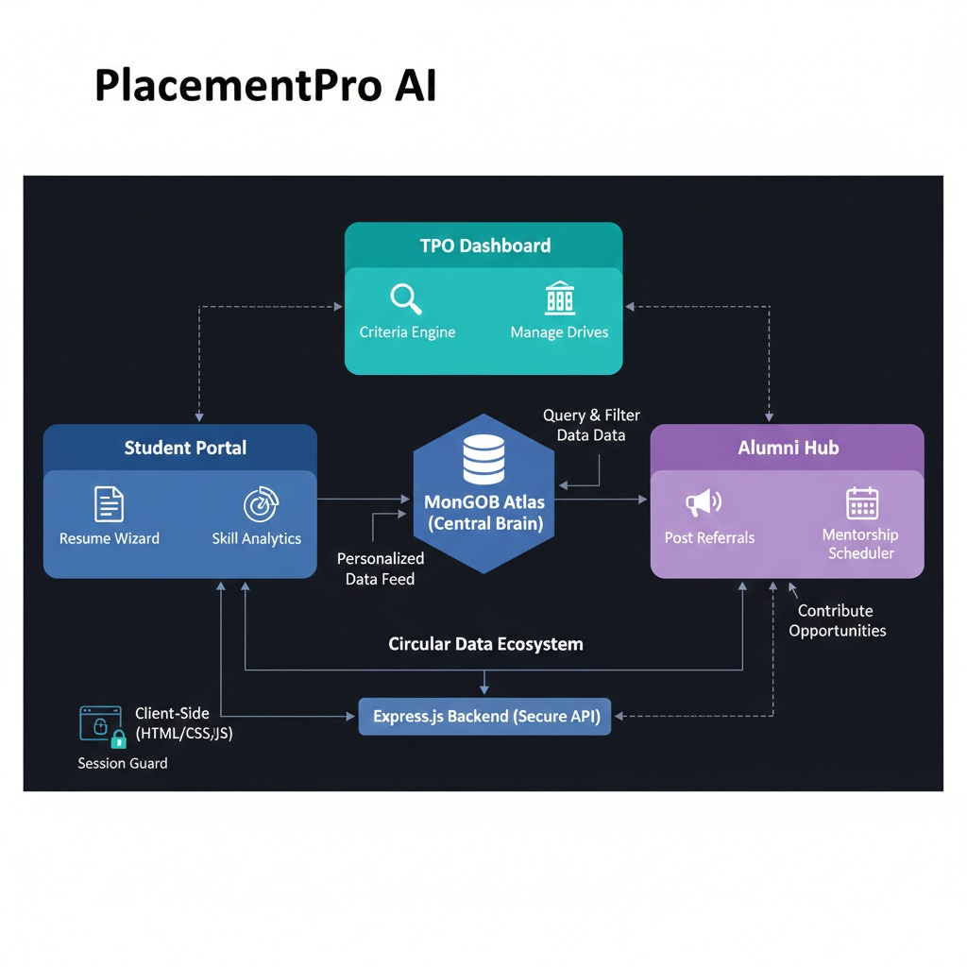
SOLVE-A-THON 1.0
IDEA TITLE
Main Title: PlacementPro AI: The Future of Unified Campus Recruitment
Tagline: Bridging the gap between Ambition and Opportunity through Intelligence and Integration.
The Core Vision: Unified Ecosystem: A single, synchronized platform for TPOs, Students, and Alumni.
Data-Driven Intelligence: Using automated eligibility engines and skill-gap analytics to maximize placement success.
Networking with Purpose: Transforming the passive alumni database into an active, referral-driven career engine.
Efficiency at Scale: Automating the 70% of manual tasks that slow down the traditional placement process.

Slide 3
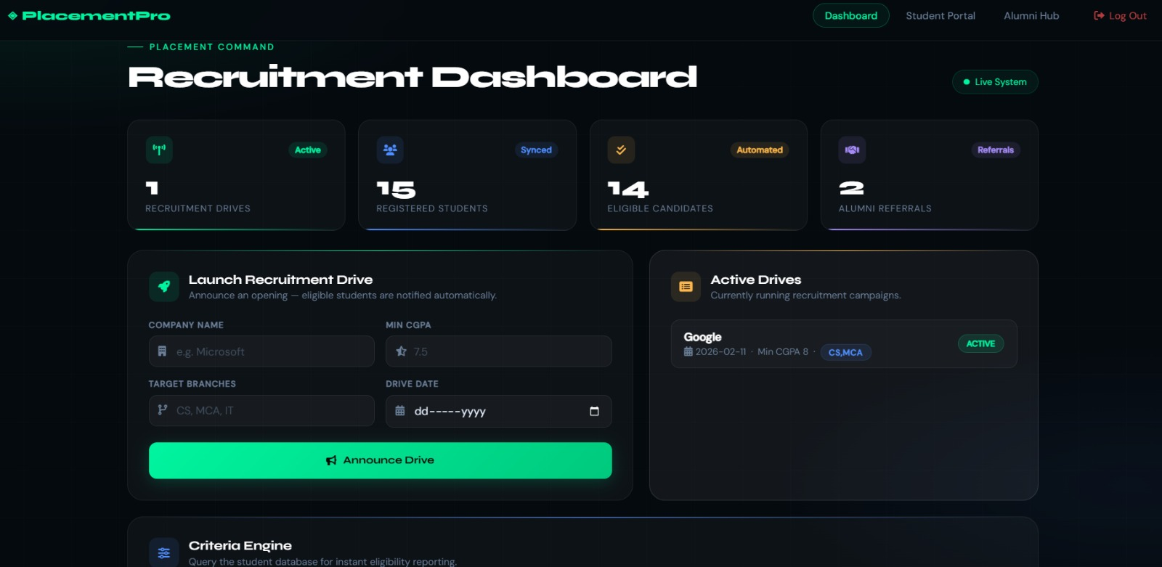
SOLVE-A-THON 1.0
TECHNICAL APPROACH
Stack: MERN Stack (MongoDB, Express, React/HTML, Node.js).
Architecture: Role-Based Access Control (RBAC) for TPOs, Students, and Alumni.
Key Logic: * Automated Eligibility Engine: Instant filtering using MongoDB $gte and $in operators for CGPA and Branch matching.
Live Feed Synchronization: Real-time job broadcasts from TPOs to personalized student dashboards.
Market Intelligence: Logic-driven Skill Gap Analysis based on current industry hiring trends.

Slide 4
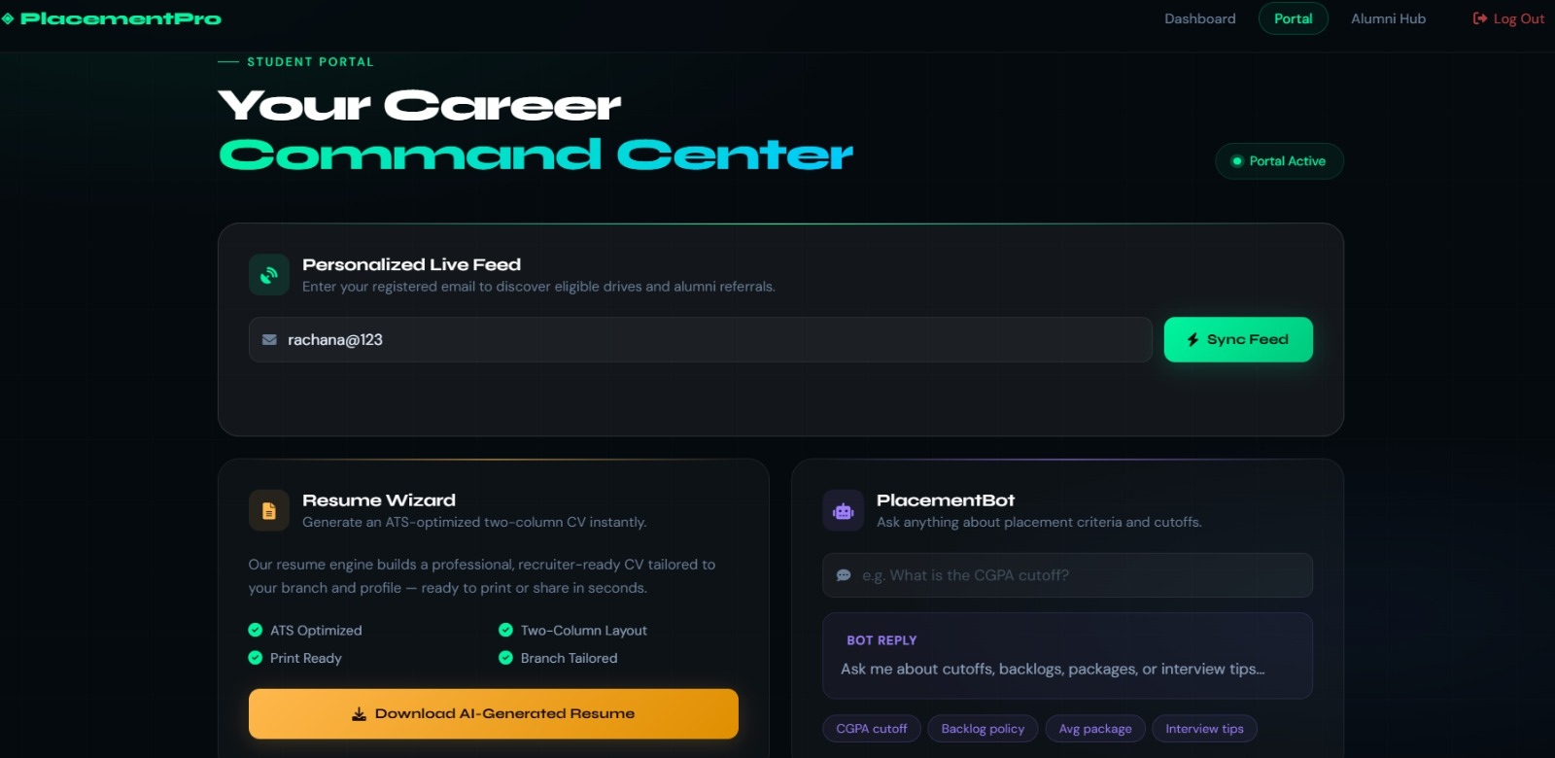
SOLVE-A-THON 1.0
FEASIBILTY AND VIABILITY
Scalability: Hosted on MongoDB Atlas with IP whitelisting for global access and 99.9% uptime.
Low Friction: Simple, responsive web interfaces require zero student training.
Security: Email-based student verification and data isolation for privacy.
Future Proof: The modular API structure allows for easy integration of Video Interview modules or Resume Parsers.

Slide 5
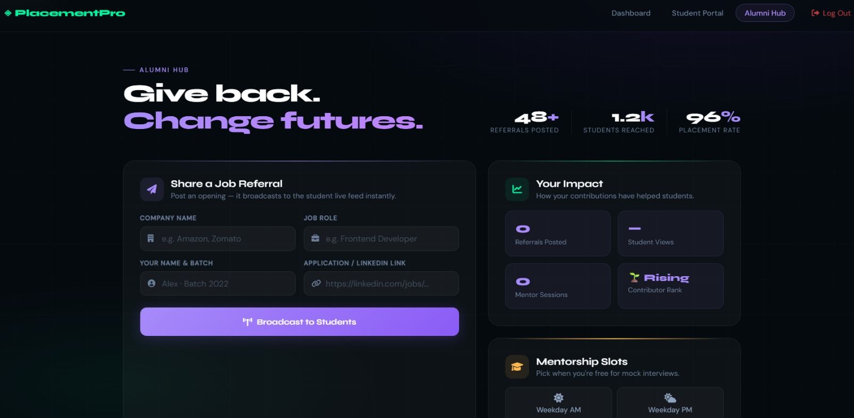
SOLVE-A-THON 1.0
IMPACT AND BENEFITS
For TPOs: 70% reduction in manual eligibility checking and database management.
For Students: Personalized career roadmaps through Skill Gap Analysis and one-click Resume generation.
For Alumni: A structured "Give-Back" channel via the Alumni Referral Board, increasing placement rates by an estimated 30%.
For the Institution: Centralized data repository for NIRF and NAAC accreditation reporting.

Slide 6
SOLVE-A-THON 1.0
RESEARCH AND REFERENCES
Recommender Systems Handbook
Publisher: Springer
🔗 https://link.springer.com/book/10.1007/978-1-4899-7637-6
2. Resume Information Extraction with Named Entity Recognition
Conference: IEEE
🔗 https://ieeexplore.ieee.org/document/8463869
3. Chatbots in Education: A Systematic Review
Journal: Computers & Education
🔗 https://www.sciencedirect.com/science/article/pii/S0360131520300992
4. Social Networking Sites and Alumni Engagement
Journal: Computers in Human Behavior
🔗 https://www.sciencedirect.com/science/article/pii/S0747563213000994

